Slide 1
IBM University Engagement Project Submission
“Exploring the Power of Agentic AI with IBM Granite and IBM Bob”

Slide 2

Predictive Maintenance of Industrial Machinery
Mechanical Engineering: (Machine Learning project)
Student Name | Recent Passport Photo | Email ID | Mobile number [WhatsApp]
Shivanandini S |  | Shivanandinisubramanian@gmail | 6379309281

Slide 3
Predictive Maintenance of Industrial Machinery
The Challenge
Industrial machines operate continuously under changing temperature, rotational speed, torque, and tool-wear conditions. Unexpected machine failures can lead to unplanned downtime, maintenance delays, production losses, and increased operational costs. Traditional reactive or fixed-schedule maintenance may not identify developing failure risks early enough.
The Objective
Build an AI-powered Predictive Maintenance System that analyzes machine operating data to identify machine failure risk and support timely maintenance decisions.
The solution should:
Failure Prediction – Predict the probability of machine failure from sensor/operational data.
Risk Assessment – Convert prediction probability into clear machine-health risk levels.
Explainable AI – Identify the most important factors contributing to the predicted risk.
Inspection Priority – Help prioritize machines/observations requiring attention.
Maintenance Recommendation – Provide practical, rule-based maintenance guidance.
What-if Simulation – Allow users to change operating conditions and observe how predicted risk changes.
IBM Cloud Deployment – Train and deploy the predictive model using IBM watsonx.ai Studio and watsonx.ai Runtime.
Interactive Dashboard – Provide a user-friendly interface for prediction, explanation, and decision support.

Slide 4
Predictive Maintenance of Industrial Machinery
Proposed Solution: AI-Powered Predictive Maintenance System
The proposed solution is an intelligent machine-health decision-support system built using IBM Bob, Python, machine-learning models, IBM watsonx.ai Studio, and watsonx.ai Runtime. The system analyzes industrial machine operating data to predict failure risk and convert predictions into actionable maintenance insights. IBM watsonx.ai Studio is used for data analysis and model development, while watsonx.ai Runtime is used to run and deploy the ML solution.
At its core, YantraGuard AI uses the AI4I 2020 Predictive Maintenance Dataset and follows a leakage-safe ML workflow covering data validation, preprocessing, feature engineering, model training, and evaluation.
The system evaluates Logistic Regression, Random Forest, and XGBoost models and selects the best model based on failure-focused evaluation metrics rather than accuracy alone.
The solution provides several key capabilities:
Machine Health Prediction — Predicts the probability of machine failure from operating conditions.
Risk Assessment — Converts failure probability into understandable risk levels such as Low, Moderate, High, and Critical.
Explainable AI — Identifies important risk drivers using model feature importance/SHAP to make predictions understandable.
Inspection Priority — Helps determine which observations require greater inspection attention.
Maintenance Recommendation — Generates practical, rule-based maintenance guidance based on predicted machine condition.
What-if Simulation — Allows users to modify operating parameters and observe how the model-based failure risk changes.
The trained model is deployed through an IBM watsonx.ai Runtime deployment space and exposed through an online inference endpoint, allowing the YantraGuard dashboard to obtain real-time predictions.
Overall, YantraGuard AI transforms raw machine sensor data into a complete Prediction → Explanation → Risk → Decision → Maintenance workflow, helping users move from reactive maintenance toward data-driven predictive maintenance.

Slide 5
Technology Used
IBM Bob – For AI-assisted project development, code generation, debugging, testing, and application orchestration.
Python – For data processing, feature engineering, machine-learning development, and backend logic.
Machine Learning – Logistic Regression, Random Forest, and XGBoost for predictive machine-failure classification.
SHAP – For explainable AI and identifying the key features influencing machine-failure predictions.
IBM Cloud – Provides the cloud infrastructure for securely developing, managing, and deploying YantraGuard AI.
IBM watsonx.ai Studio – For dataset analysis, Jupyter notebook development, model training, evaluation, and experimentation.
IBM watsonx.ai Runtime – For registering, deploying, and serving the trained predictive-maintenance model through an online inference endpoint.
IBM Cloud Object Storage – For storing the AI4I dataset and project/model assets.
Streamlit – For building the interactive YantraGuard AI dashboard for machine-health prediction, risk assessment, explanations, recommendations, and what-if analysis.

Slide 6
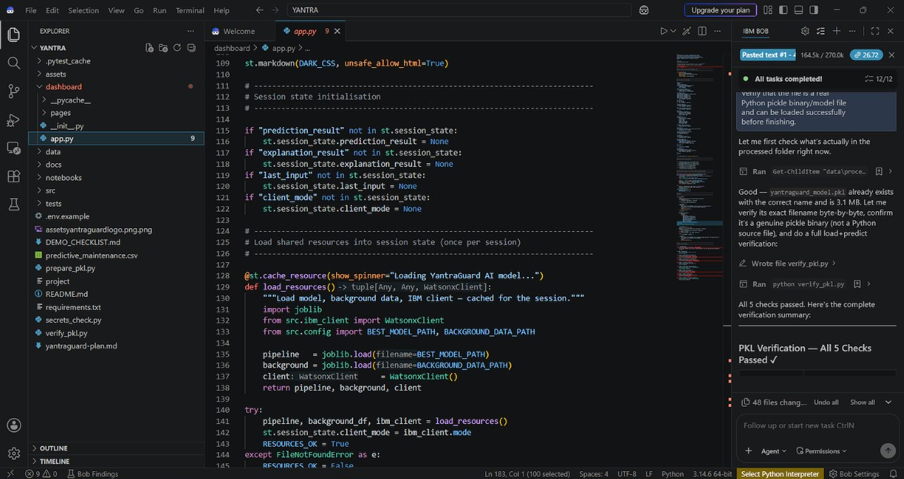
Required Files created using IBM bob -

Slide 7
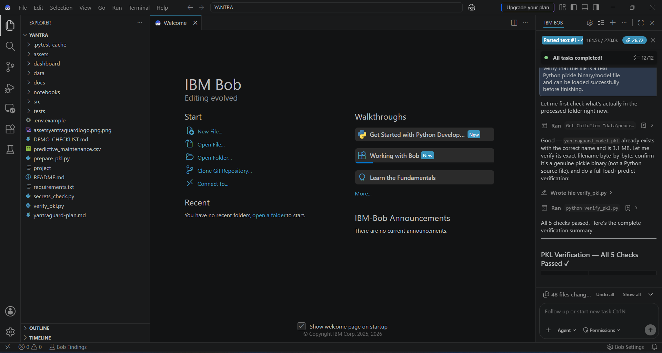
IBM Bob Screenshots:

Slide 8
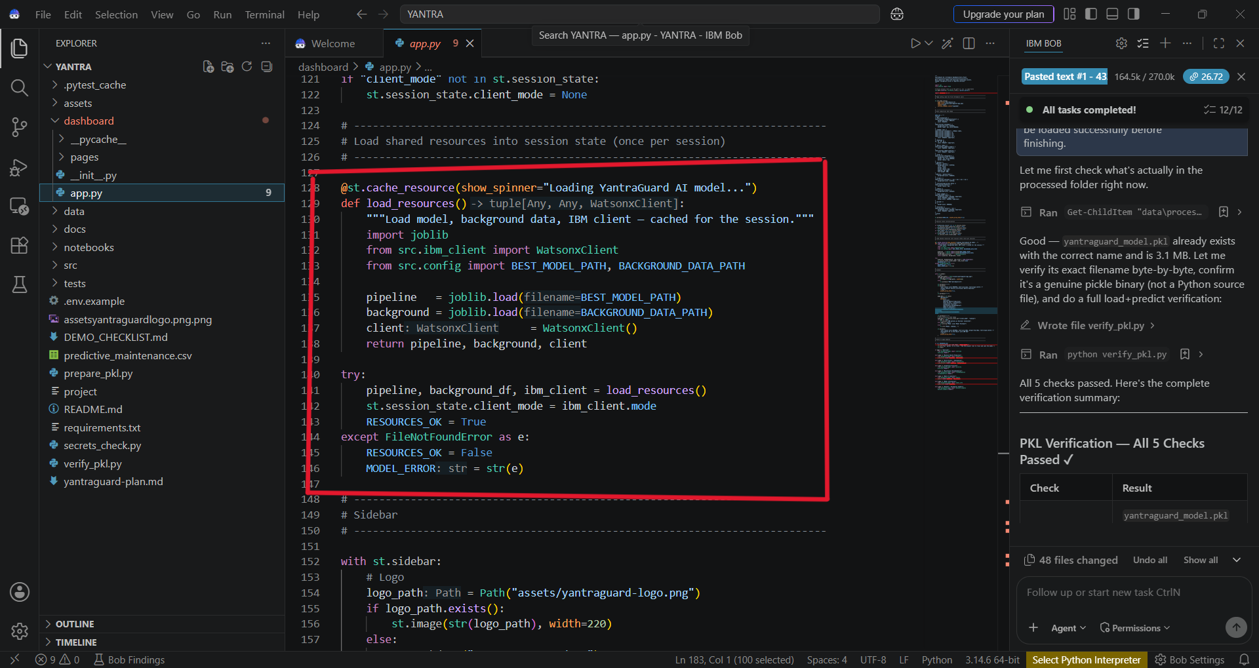

Slide 9
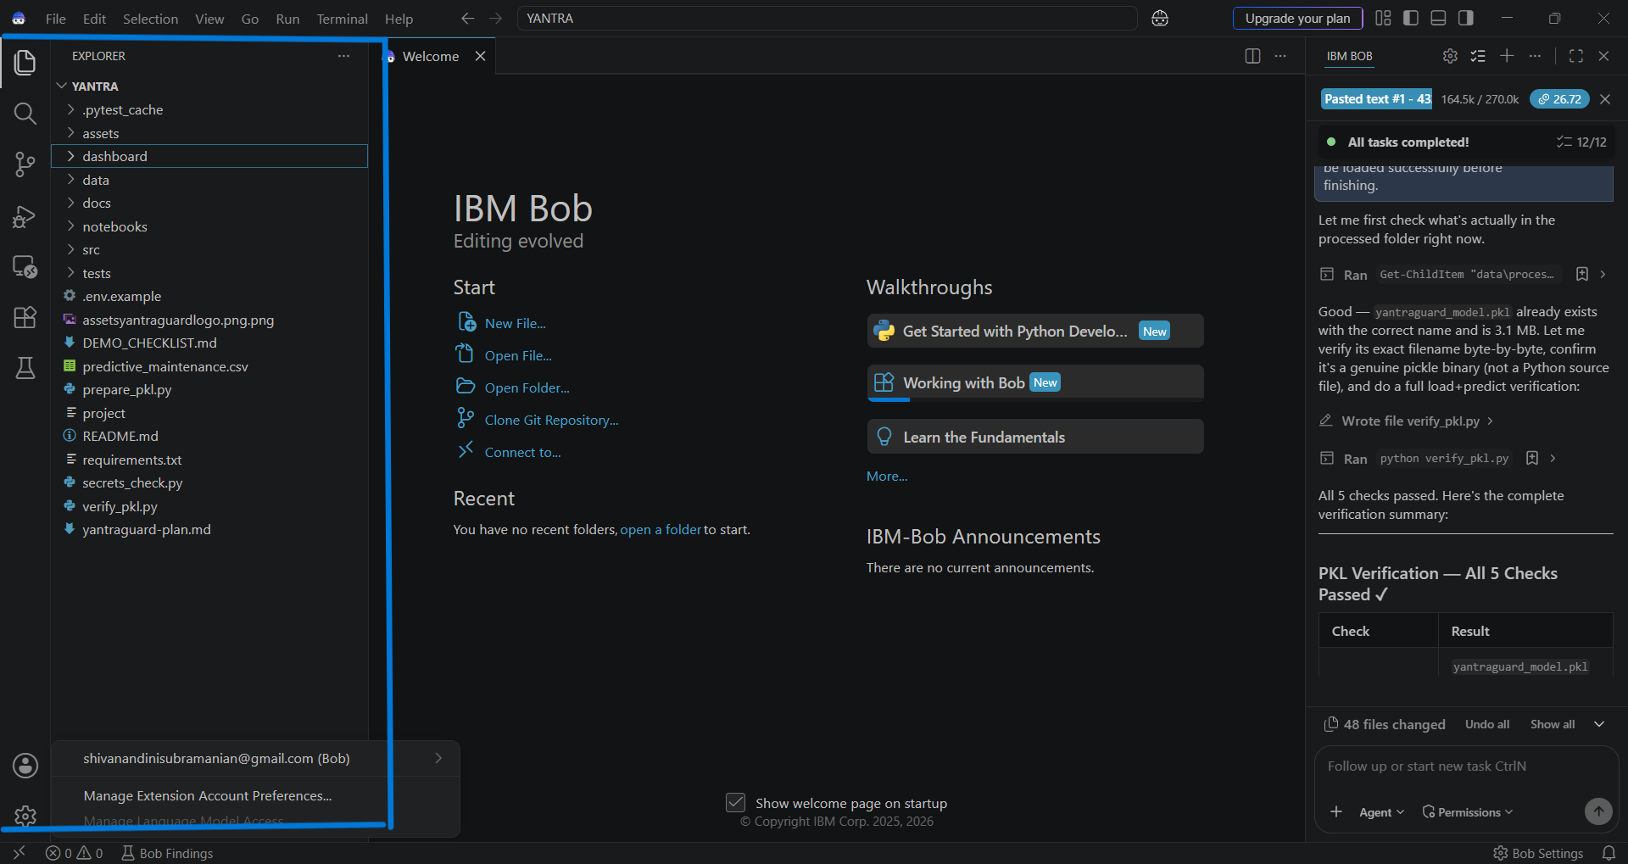

Slide 10
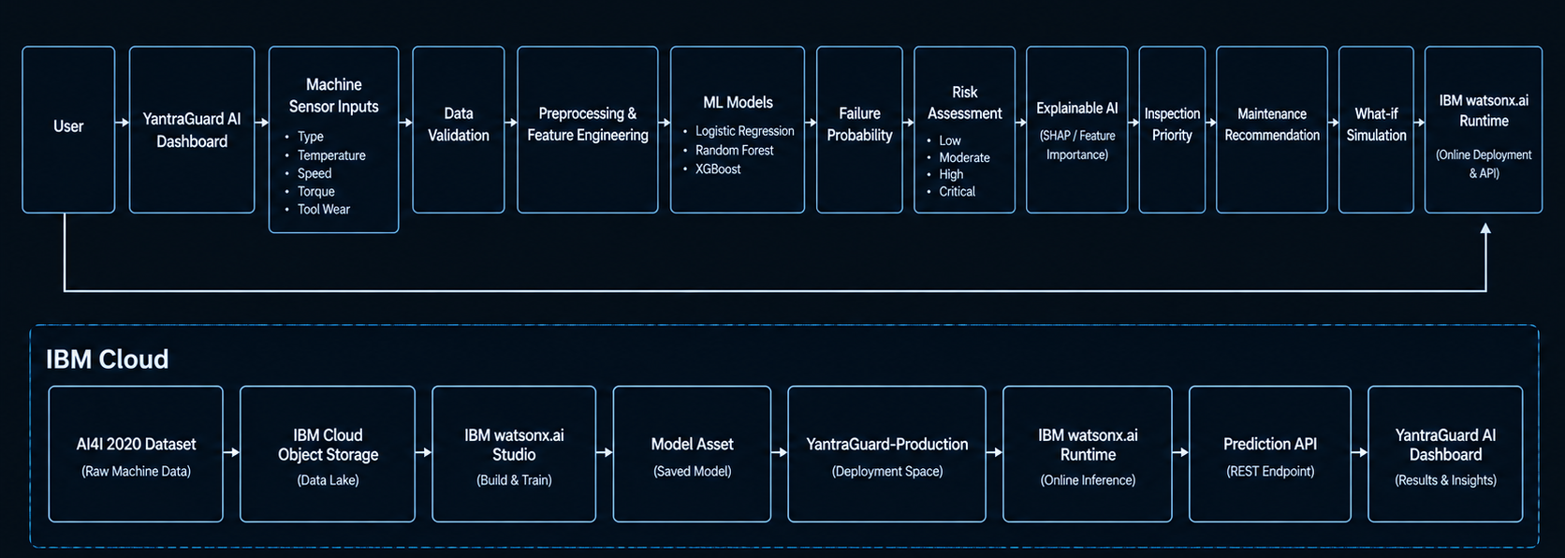
Architecture blueprint for IBM bob:

Slide 11

Role of Agentic AI in the solution
Role of Agentic AI in YantraGuard AI
Agentic AI enables YantraGuard AI to function as an intelligent machine-health decision-support system rather than a simple prediction tool. Using IBM watsonx.ai and IBM Bob, the solution coordinates multiple stages of the predictive-maintenance workflow.
The system processes machine sensor inputs such as temperature, rotational speed, torque, and tool wear, validates the data, and uses machine-learning models to estimate machine failure probability.
Agentic AI supports intelligent decision-making by:
Analyzing sensor conditions and identifying abnormal machine patterns.
Predicting failure risk using Logistic Regression, Random Forest, and XGBoost.
Explaining predictions using feature importance / SHAP-based insights.
Assigning inspection priority based on predicted risk and defined severity rules.
Generating maintenance recommendations according to the detected risk level.
Supporting what-if analysis by allowing users to test how changing sensor conditions can affect predicted risk.
Overall, Agentic AI connects prediction → explanation → prioritization → recommendation, helping maintenance teams make faster and more informed decisions before potential machine failure.
YantraGuard AI acts as an intelligent maintenance assistant that helps users predict, understand, and respond to machine-health risks.

Slide 12
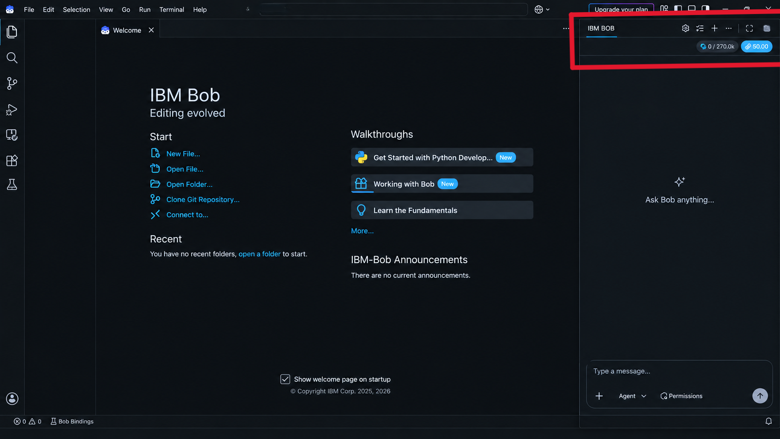
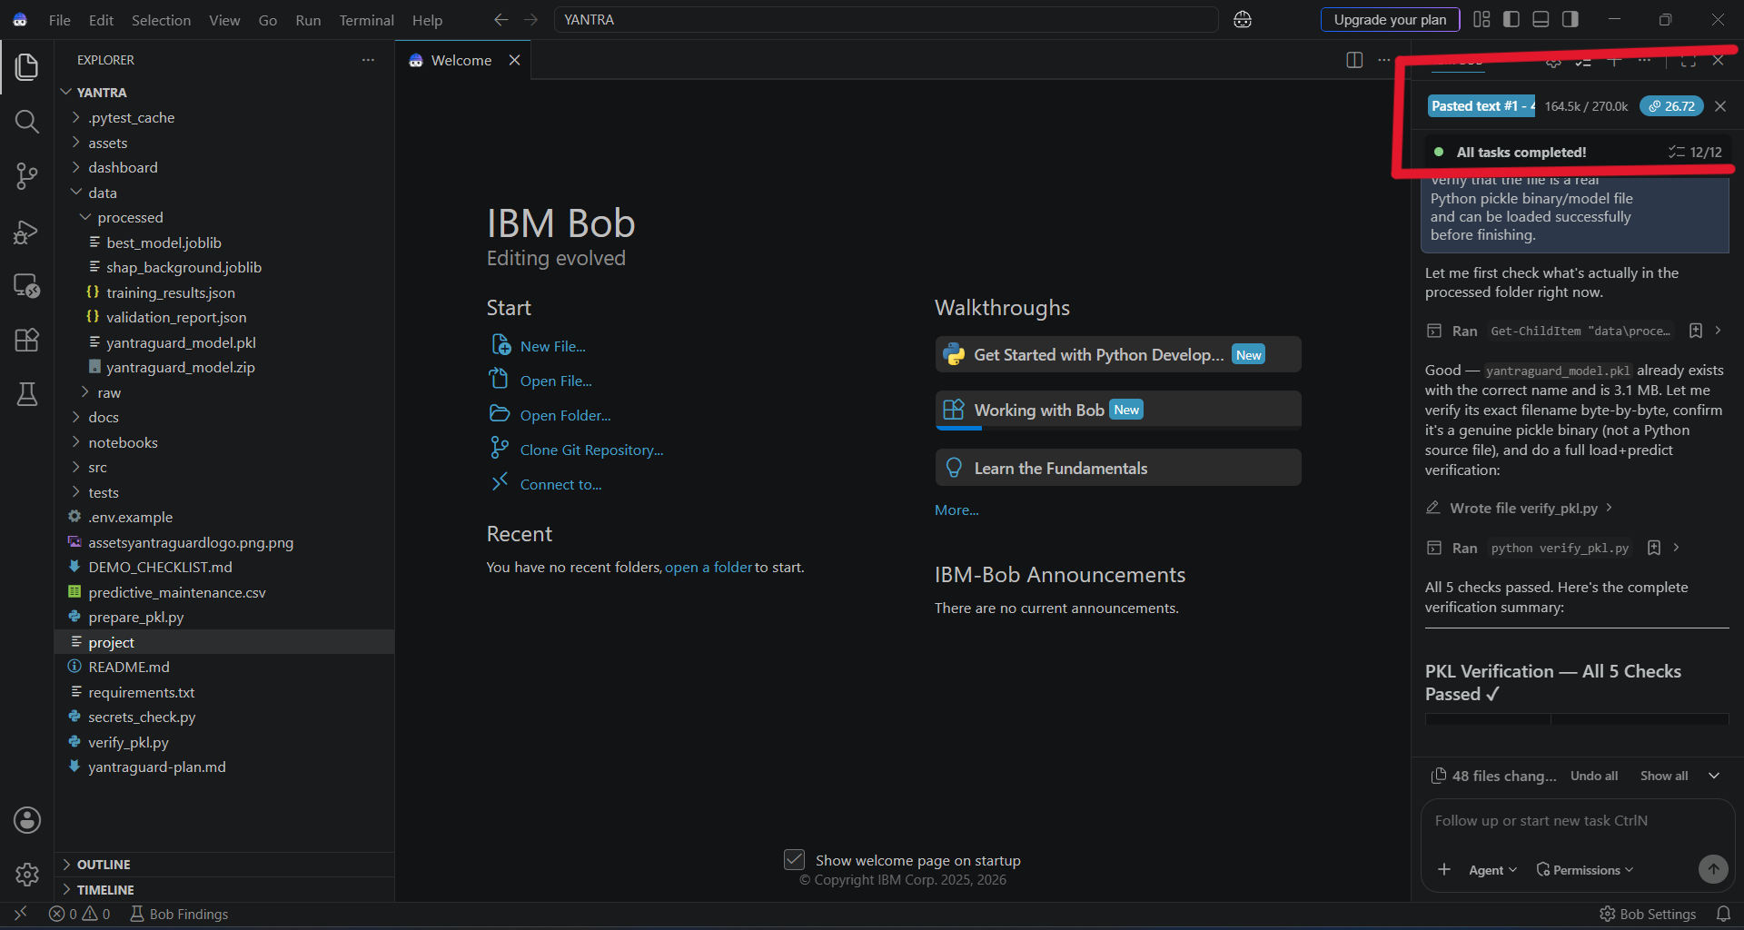
Token Usage
11,761 token are used
Before Prompt
After the Prompt
·
·
·

Slide 13
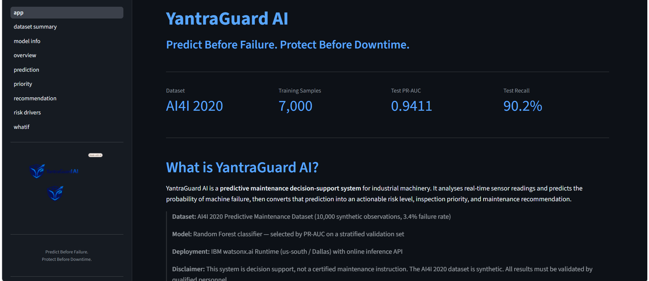
Project Output Screenshot
·
·
·

Slide 14
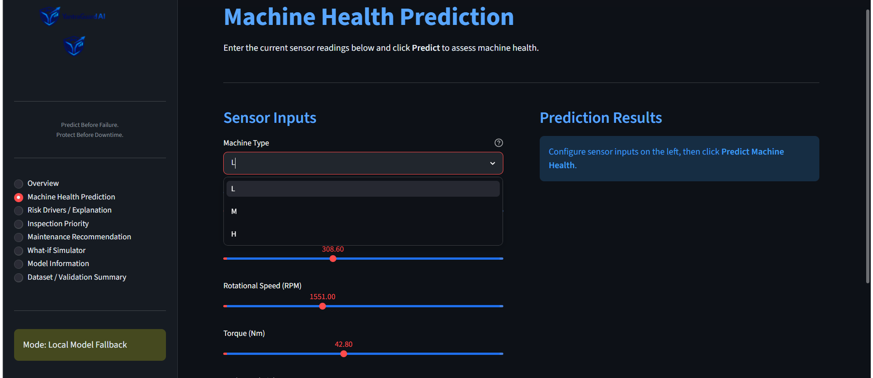
Project Output Screenshot
·
·
·

Slide 15
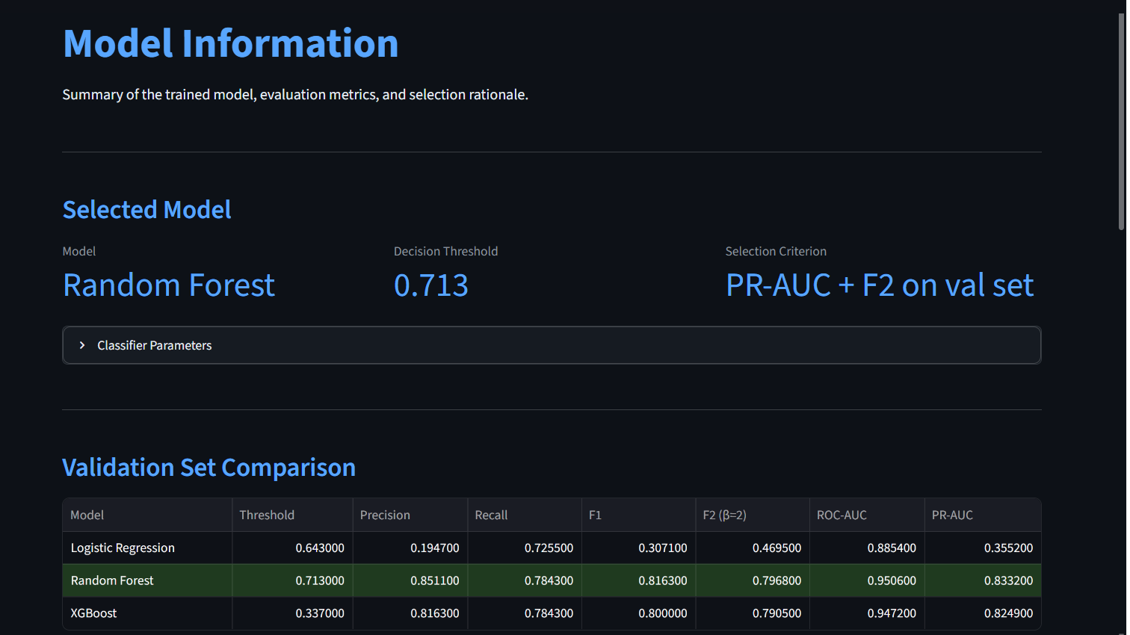

Slide 16
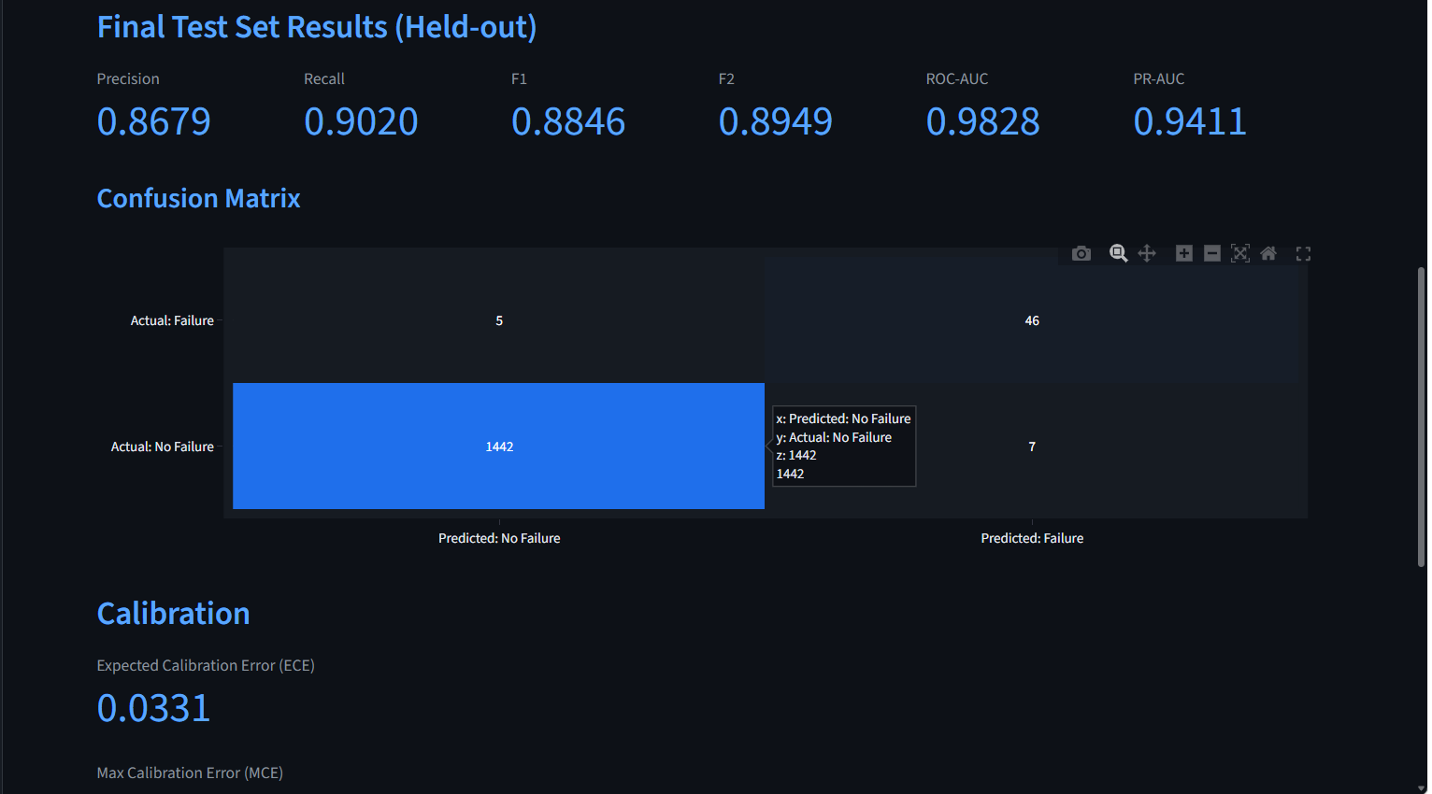

Slide 17
Novelty and Uniqueness
YantraGuard AI stands out by combining Predictive Machine Learning, Explainable AI, Risk Assessment, and Maintenance Decision Support into a single intelligent predictive-maintenance system.
Failure-Risk Prediction – Uses machine operating and sensor parameters to predict the probability of machine failure before relying on reactive maintenance.
Multi-Model Intelligence – Evaluates Logistic Regression, Random Forest, and XGBoost to identify the most suitable model based on failure-focused performance.
Leakage-Safe Prediction – Explicitly excludes target-derived and leakage-prone variables, improving the reliability and validity of the predictive pipeline.
Explainable AI – Uses feature importance / SHAP to show the key operating factors contributing to the predicted machine-failure risk.
Intelligent Risk Assessment – Converts failure probability into understandable Low, Moderate, High, and Critical machine-health risk levels.
Maintenance Decision Support – Goes beyond prediction by providing inspection priority and rule-based maintenance recommendations based on machine condition.
What-if Simulation – Allows users to modify operating parameters and observe how the model-based failure risk changes under different scenarios.
IBM Cloud Deployment – Uses IBM watsonx.ai Studio and watsonx.ai Runtime to develop and deploy the machine-learning solution through an online inference service.
Interactive Dashboard – Provides a user-friendly Streamlit interface that combines prediction, explanation, risk assessment, recommendations, and what-if analysis in one application.
Overall, YantraGuard AI transforms predictive maintenance from simple failure prediction into an integrated, explainable, and decision-oriented machine-health system.

Slide 18
Git Hub Link
shivanandini07/IBM-YANTRA: An IBM Cloud-powered predictive maintenance system that uses machine learning to predict equipment failure risk, explain key risk factors, prioritize inspections, recommend maintenance actions, and support what-if machine-health analysis.
·
·
·

Slide 19
Future Scope
Real-Time IoT Integration – Integrate live industrial sensors for continuous machine-health monitoring.
RUL Prediction – Extend the system to estimate the Remaining Useful Life of machine components.
Multi-Machine Monitoring – Expand YantraGuard AI to monitor and prioritize multiple machines.
Automated Alerts – Generate real-time maintenance alerts when failure risk becomes critical.
Continuous Learning – Incorporate new machine data for model monitoring and periodic retraining.
Digital Twin Integration – Simulate machine operating conditions for advanced predictive-maintenance decisions.
Edge AI Deployment – Enable fast machine-health predictions closer to industrial equipment.
Enterprise Scaling – Extend the solution into a large-scale industrial predictive-maintenance platform.
·
·
·

Slide 20
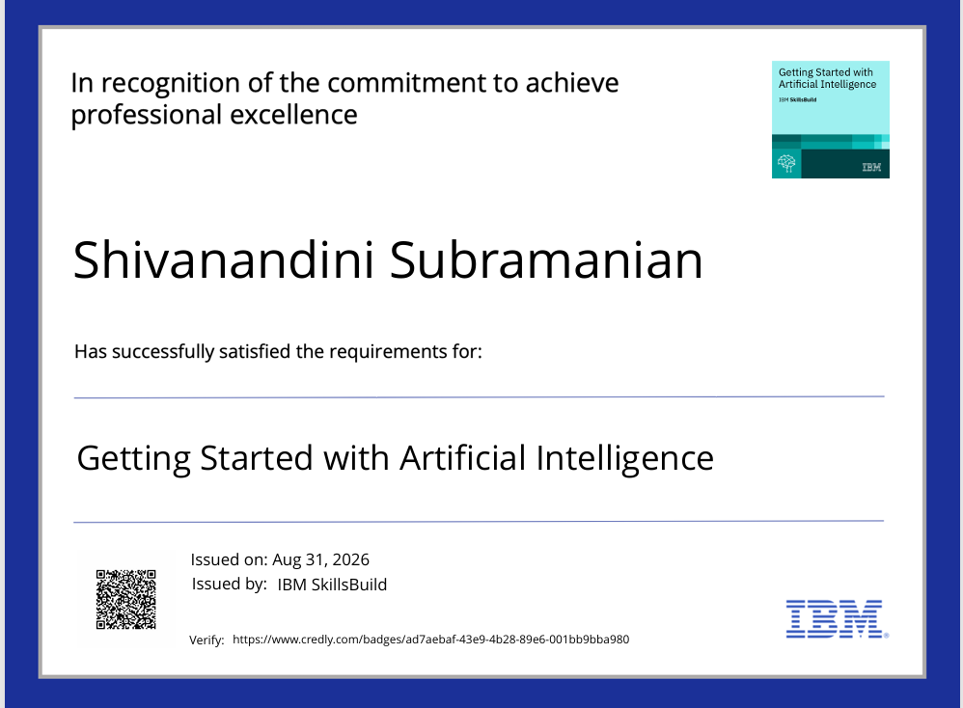
Certificates Earned:
Getting Started with Artificial Intelligence

Slide 21
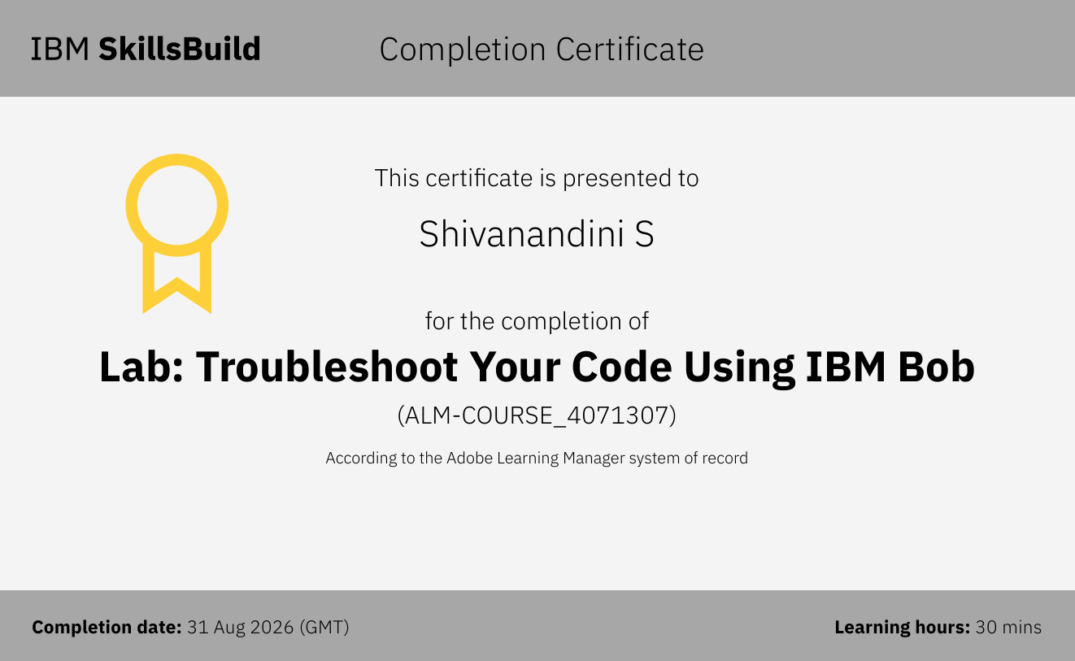
Certificates Earned:​
IBM BOB Certificate

Slide 22
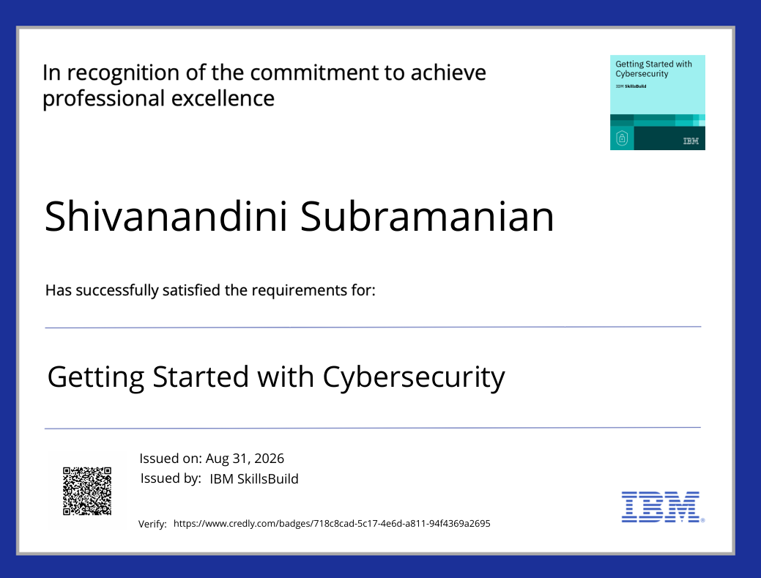

Slide 23
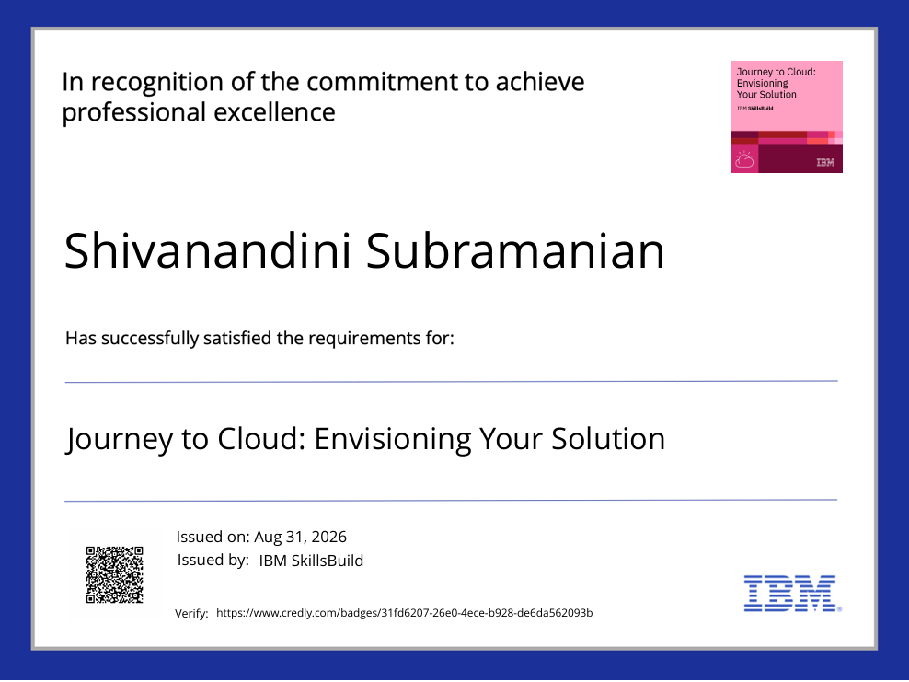

Slide 24
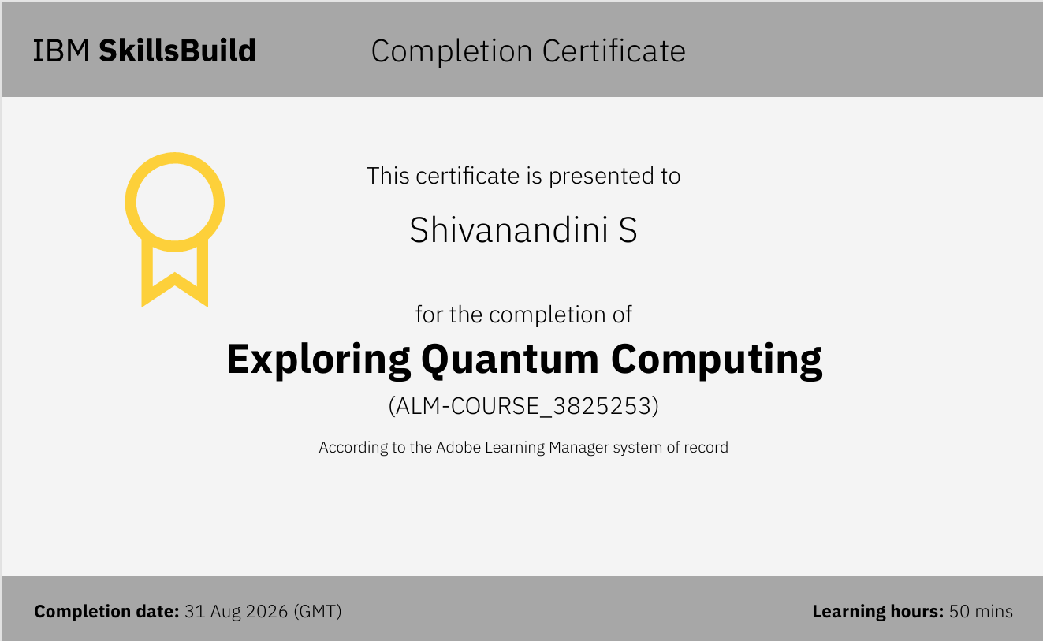

Slide 25
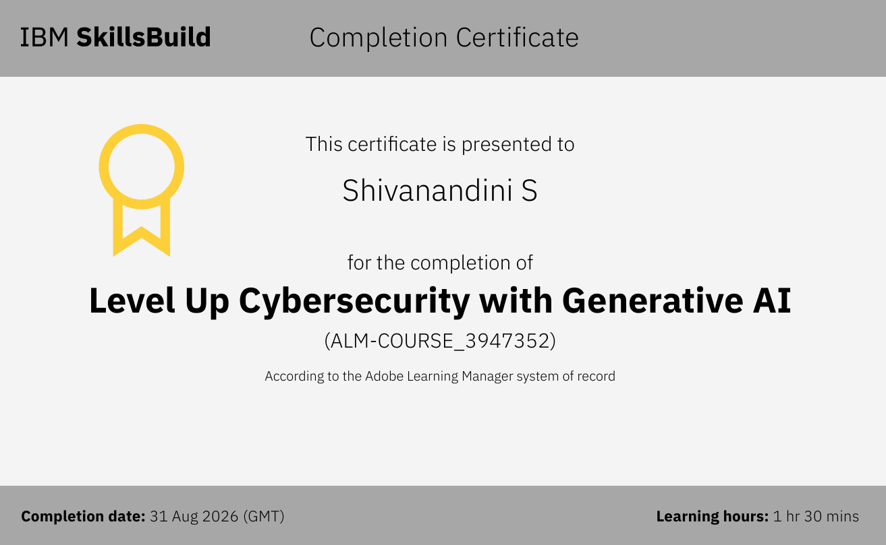

Slide 26
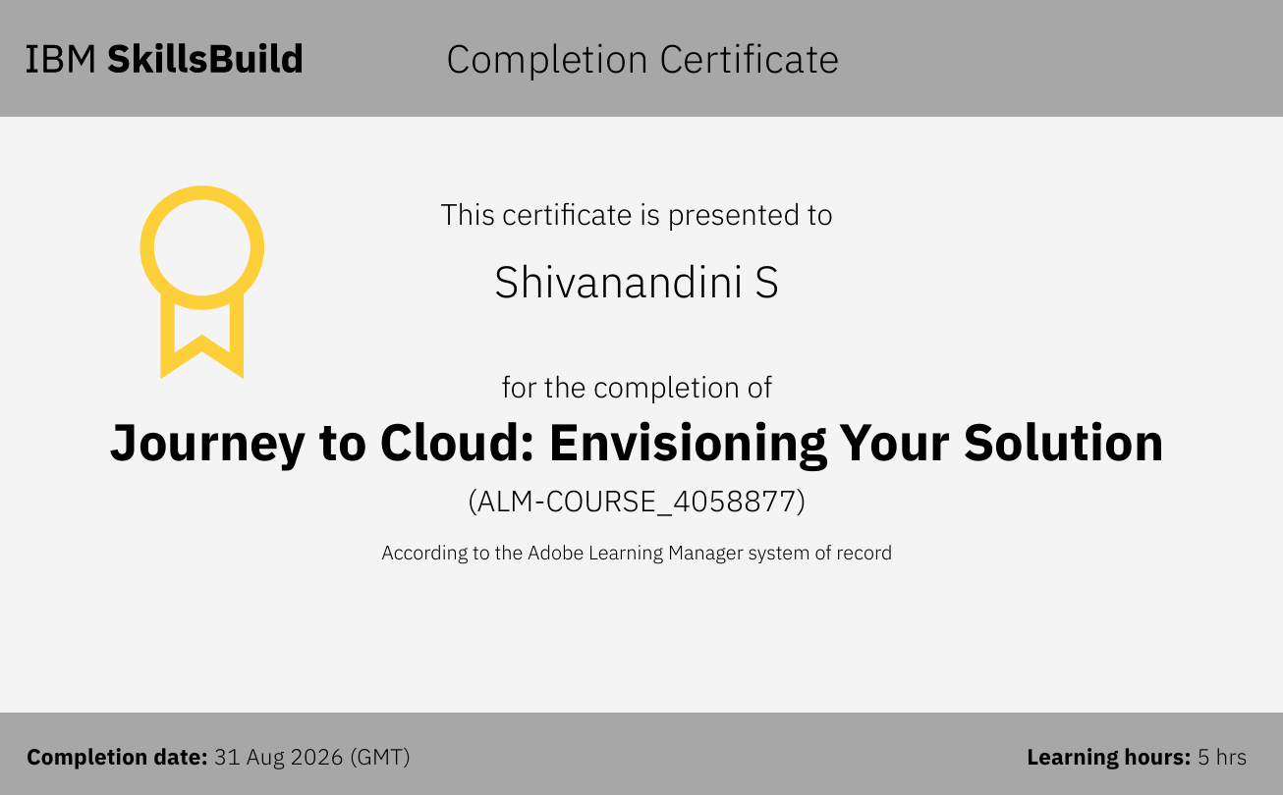

Slide 27


